Slide 1

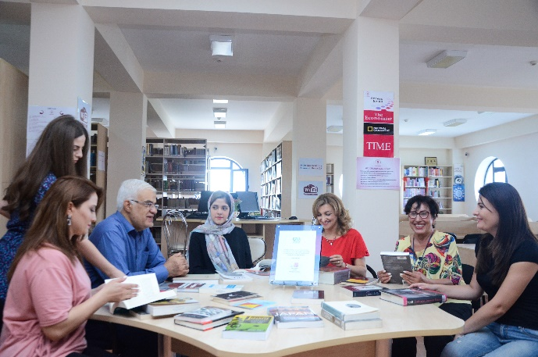
Introduction to Electronic Resources:
Khazar University
Library & Information Center
Tatyana Zayseva
LIC Director
25 October, 2019

Slide 2
WHAT WE ARE COVERING
Introduce freshman and transfer students to:
  Customer oriented services, resources, and operations of the Library & Information Center.
  Resources for finding books, e-books, and journal articles.
  Library Website.
  Bibliographic Citation.
  Avoiding Plagiarism.

Slide 3
STUDIES SHOW…
Students who use the library have a higher cumulative GPA than students who do not. (Soria, et. al.)
Users of Library Services
Average GPA
Non-users of Library Services Average GPA
3.18
2.98
Soria, Krista M., et. al., “Library Use and Undergraduate Student Outcomes: New Evidence for Students’ Success and Retention” Libraries and the Academy, Vol. 13, No. 2 (2013), pp. 147-164. Johns Hopkins University Press, Baltimore, MD.

Slide 4
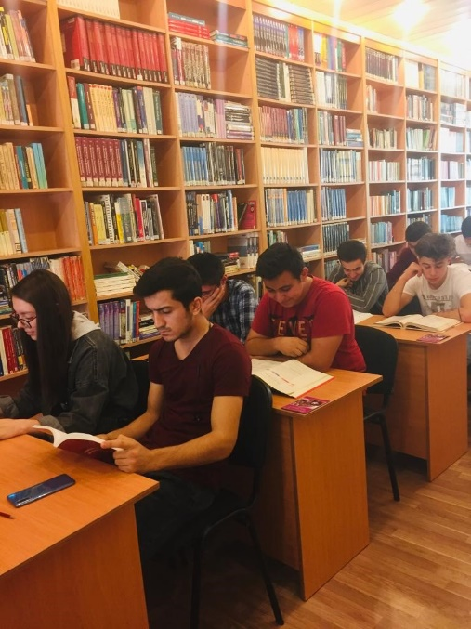
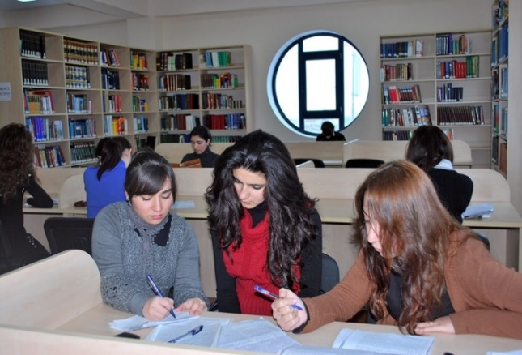

Khazar University LIC
The University has Libraries at the Downtown, Dunya School and Sumqayit Dunya Campuses.

Slide 5
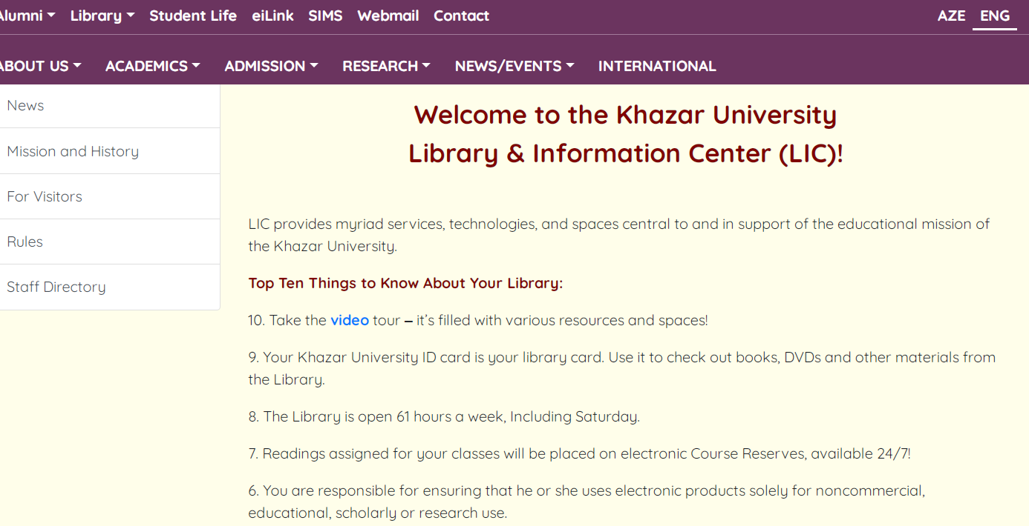
Our Website
www.khazar.org
Information on borrowing, inter-library loans, regulations and periodicals can all be viewed from library website
http://khazar.org/en/item/1312
Notes:
.
:
LIC provides various services, technologies, and spaces central to and in support of the educational mission of the Khazar University.
Top Ten Things to Know About Your Library, the most important of them are following;
Your Khazar University ID card is your library card. Use it to check out books, DVDs and other materials from the Library.
The Library is open 61 hours a week, Including Saturday.
You are responsible for ensuring that he or she uses electronic products solely for noncommercial, educational, scholarly or research use.
If you need study space, there are a quiet places in the Library, but if you are working on a group project, reserve a collaboration room.
Access e-books, e-journals and e-newspapers and, research databases 24/7 from anywhere!

Slide 6
What is an ‘Electronic Library Resource’?
Any library or information resource that can be accessed via computer, e.g.
Electronic books.
Electronic journals.
Scholarly databases.
Dictionaries, encyclopedias, economic data.
Information gateways.
The Internet.
Also reports, magazines, grey literature.

Slide 7
Aims of Information Services
The primary aims of Information Services:
to support the learning, teaching and research activities.
to keep the university community informed of the library`s services and possibilities.
to develop direct communication between the library and the academic departments.

Slide 8
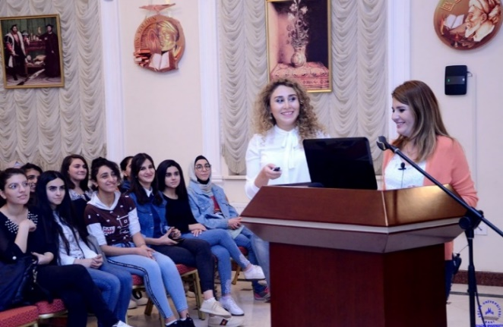
Information Services
Electronic Information Services provides IT and Library services to Khazar University's students and staff.
Research resources.
Learning materials embedded into DSpace & Moodle.
Help, advice and training on accessing these resources and applying technologies.

Slide 9
The Best Free Research Search Engine
Google Scholar (peer-reviewed papers, theses, books, abstracts and articles from academic publishers, professional societies, preprint repositories, etc);
Google Books (thousands of books, from popular titles to old);
Microsoft Academic (content from over 120 million publications, including scientific papers, conferences and journals);
Worldwide Science - The Global Science Gateway;
Science.gov (over 60 databases, over 2,200 websites and 200 million pages of journals);
Wolfram Alpha (A self-described “computational knowledge engine”);
Refseek (over one billion web pages, encyclopedias, journals and books);
Educational Resources Information Center (more than 1.3 million bibliographic records of articles and online materials);
Virtual Learning Resources Center (thousands of scholarly websites);
iSeek (help to find exactly what you are looking for);
ResearchGate (a unique social networking site for scientists and researchers);
BASE (Bielefeld Academic Search Engine) search engines especially for academic web resources
Infotopia “Google-alternative safe search engine”;
PubMed Central (perfect for those studying anything related to healthcare or science);
Lexis Web (researching legal topics).

Slide 10
List of eResources & Services
CATALOGUE Search/Login | DATABASES | LIBRARY NEWS Facebook/Twitter Instagram
DSPACE dspace.khazar.org | EBOOKS/Calibri elib.khazar.org | Wi-Fi SERVICE User name: Khazar library Password: library123
GOOGLE SCHOLAR | LOCAL COLLECTIONS Dissertations | INTER-LIBRARY LOANS
MOODLE elearning.khazar.org | ePORTFOLIO eportfolio.khazar.org | REFERENCE EndNote Web
Notes:
This list contains direct links to the webpages of these resources.
Use Google Scholar to begin your search for scholarly resources. Google Scholar covers a large proportion of scholarly literature including: academic journals, books, institutional repositories, preprints, case law, patents, and dissertations.
More detailed information about our e-resources will be given in the next slides

Slide 11
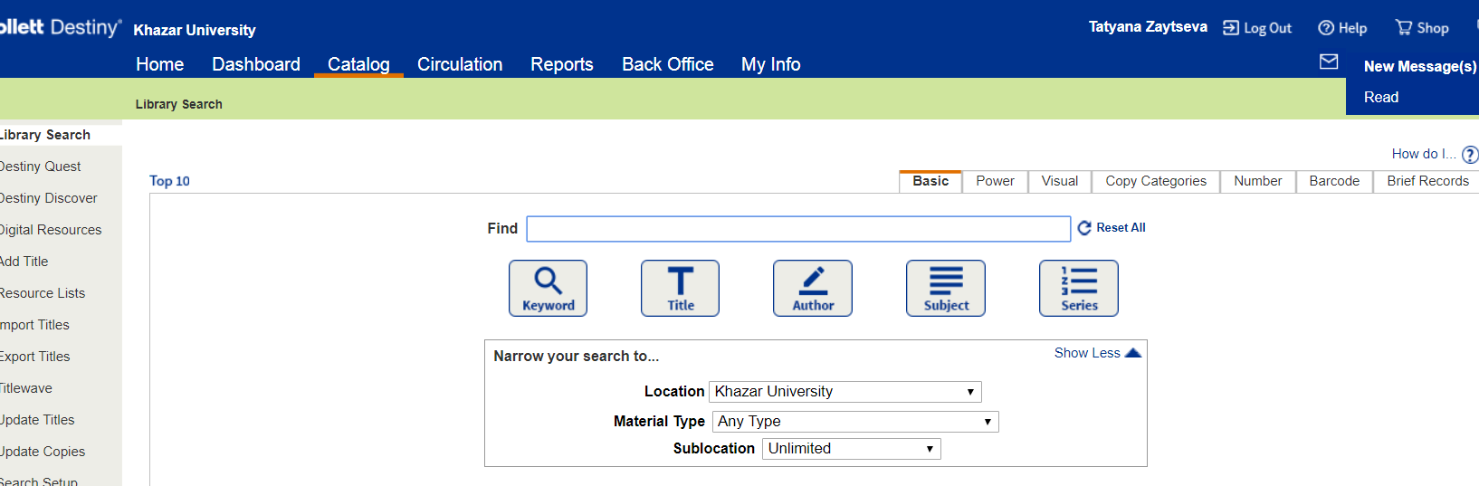
ONLINE CATALOG
To access Online catalog click on:
Main page/LIBRARY/e-Resources/eCatalogue
      https://khazaruniversity.follettdestiny.com
Notes:
Easy-to-use circulation, cataloging, inventory, and reporting capabilities
Destiny supports open standards for easy and integrated data sharing and single sign-on access,
CATALOGUE
The catalogue contains bibliographic records for the print and electronic collections of the KU Library. Go to library webpage from Khazar website than
e-Resources
eCatalogue

Slide 12
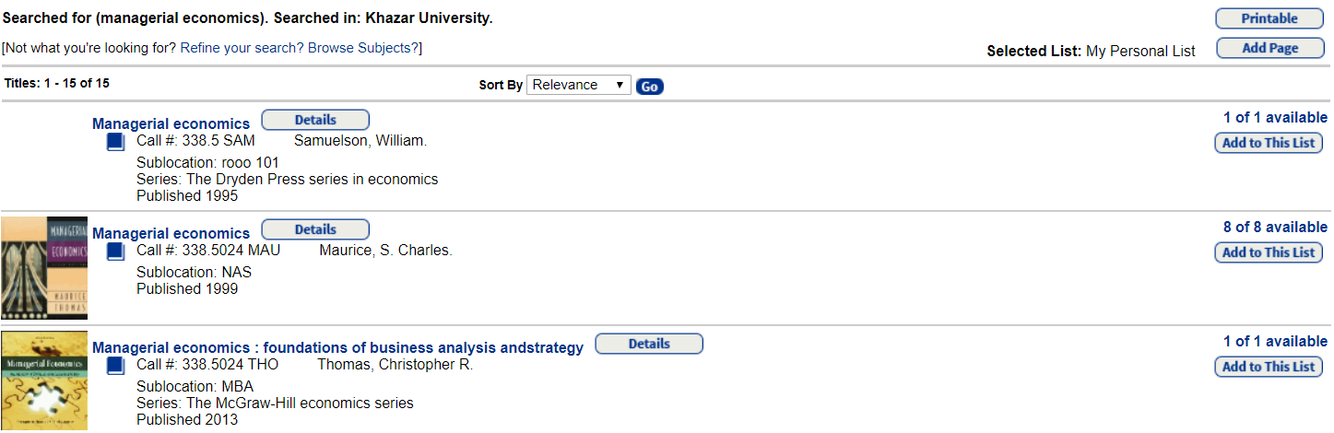
ONLINE CATALOG
Subject search: managerial economics
Notes:
Your steps:
I would like to show you a search results for topic on managerial economics, 16 books. If book is available, you can order this book from home. if the book is on hand you can stand in line
Information Services>Find Resources>Catalogue>Type “Chemistry” in the search field

Slide 13
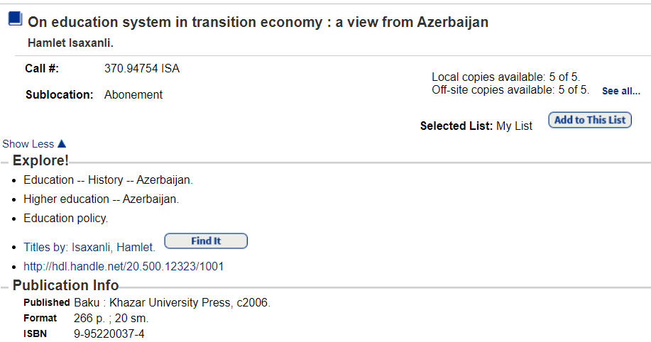

ONLINE CATALOG
Title search: On Education System: View from Azerbaijan
Full Text
Notes:
Our catalog provides access to full text documents as well . For example , search Hamlet m-m book “On education system in Azerbaijan”, CLICK ON electronic address you go to the full text of the document
eps:
Information Services>Find Resources>Catalogue>Type “Chemistry” in the search field

Slide 14
Free eBooks
Some of the main sources of free eBooks:
Google Books http://books.google.com/
Directory of Open Access Books (DOAB) http://www.doabooks.org
Project Gutenberg http://www.gutenberg.org/wiki/Category:Bookshelf
HathiTrust Digital Library http://www.hathitrust.org/
Internet Archive http://archive.org/details/texts
LIC Open Access Resources http://khazar.org/en/item/1307
Notes:
Some websites provide free access to eBooks. You should use these with caution:
:Check the publication date - is the book up-to-date? Sometimes publishers provide free access to old editions of books.

Slide 15
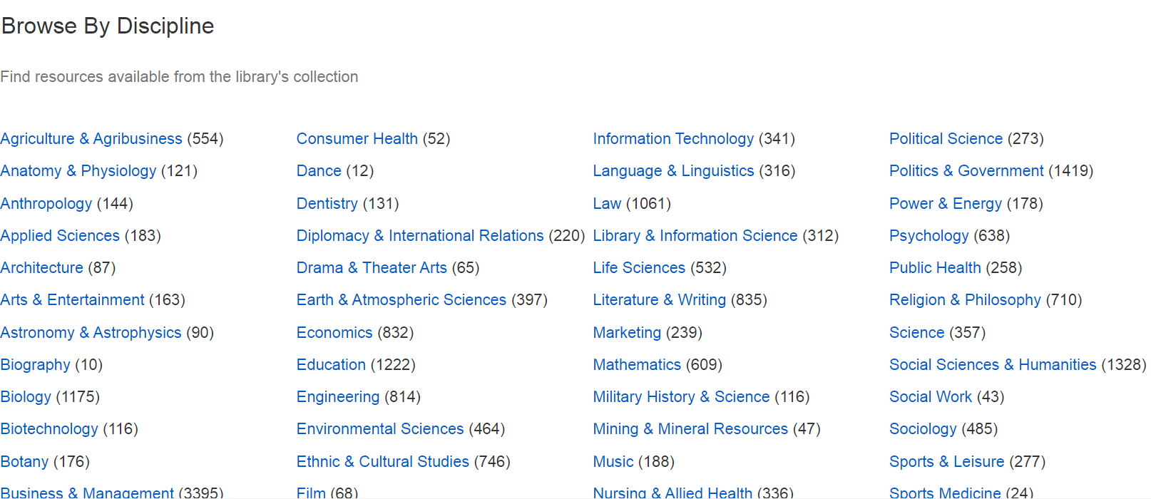
eJournals (EBSCO EDS)
Example: to access eJournals click on:
      EBSCO Discovery, then Publication, then
      Business and Management.
Notes:
On this slide I showed you how to access ejournals via ESCO Discovery on example of business and management with the limiters: peer- review journals and full text articles

Slide 16
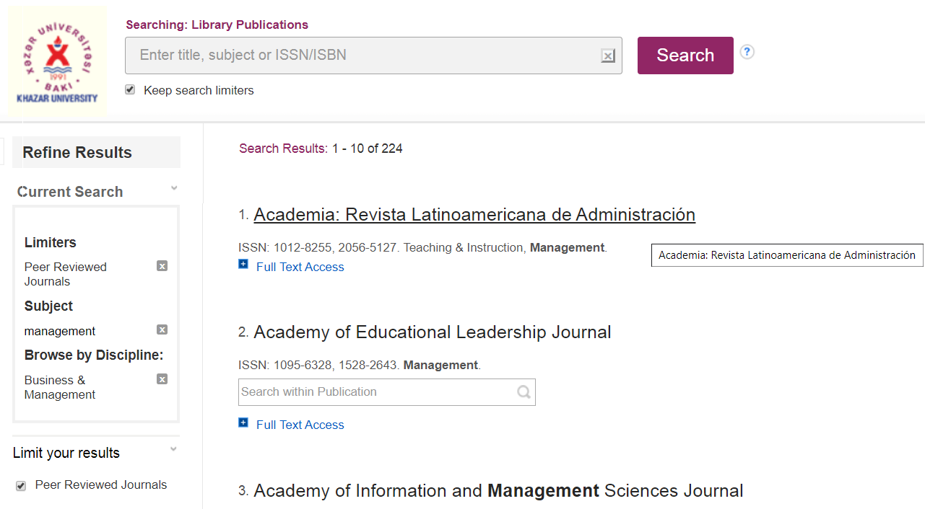
eJournals: Research Results http://search.ebscohost.com
Full text
Notes:
Index tab
Use the Index tab to view a list of databases and other sources of electronic full text titles. You can link directly to the "front door" of each source, or link to a list of titles contained in each source.
Titles tab
Use the Titles tab to browse a list of titles arranged alphabetically. You can also do simple searching of the list by using the search feature on that page. When you find the title you want, follow the links underneath its name to explore the title, including viewing full text.
Subject tab
Use the Subjects tab to browse a list of subject areas covered by the titles in our collection. Click a subject category to view a list of all titles in that category.
Search tab
The Search tab provides a more advanced search form than the search box on the Titles tab. Use the Search tab to search by title name, publisher name, or ISSN, as well as to control the search type (Begins With, Exact Match, etc.).
Titles tab - Page Navigation listbox
When viewing a list of titles that span more than one web page, this listbox will show all the pages in the current title list. For each page, the first title on the page and the last title on the page are listed. Click on a page to go directly to that section of the list.
Titles tab - "Find:"
Use this textbox to quickly search for titles whose names contain the keywords you enter. Too many results? Try the Search tab instead.
Titles tab - Alphabetical Links
Use these hyperlinks to jump to the section of the titles list that contains all titles whose names begin with the letter you click. For example, to see titles whose names begin with "A", click the "A" link.
Titles tab - Page Navigation Links
If the current list you are viewing spans more than one web page, use these links to navigate to other pages in the list. If there are many pages, try the Page Navigation Listbox (#5 above).

Slide 17
Khazar University
Print & eJournals
Title | User name | Password
National Geography | tzaytseva@khazar.org | Oks53272mak
Time | aytajmisgerli@gmail.com | Khazar_82
The Economist | tzaytseva@khazar.org | Oks53272mak
Notes:
There are some subscribed journals both in print and electronic versions.
Electronic journals have several advantages over traditional printed journals:–
You can read journal articles on your desktop, you don’t have to be in the library.
– You can e-mail articles to yourself or download them for printing.
–– Hypertext links allow you to move to different sections within individual journals
– Journals caт include more images and audio-visual material.
– Journals can be interactive – you can e-mail the author or editor with your comments

Slide 18
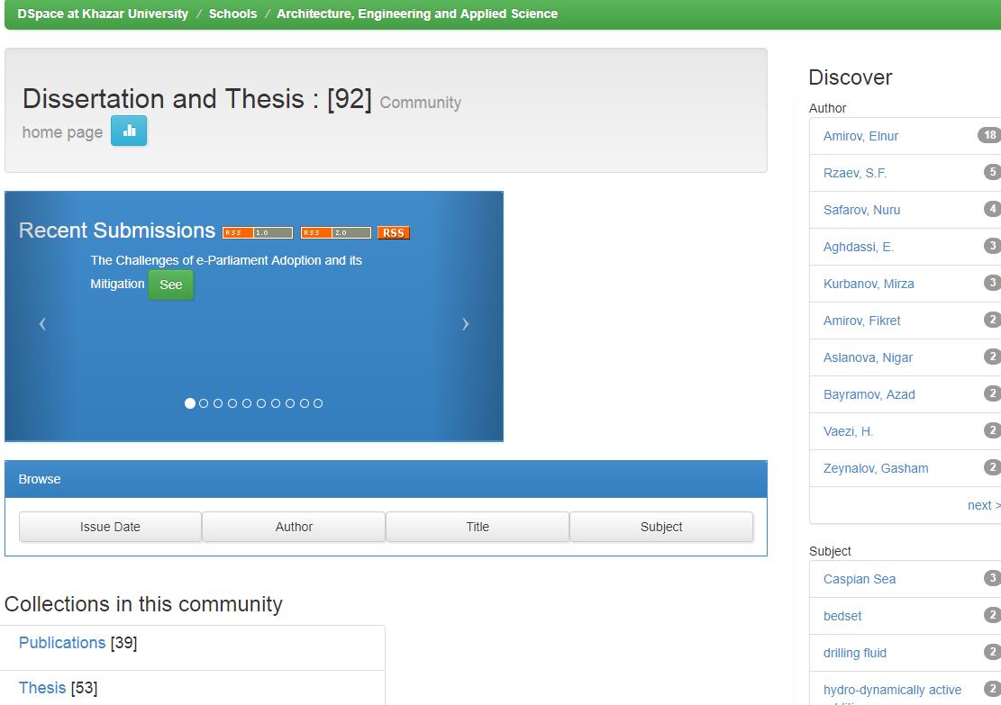
Institutional Repository http://dspace.khazar.org/
To access DSpace click on: Electronic Resources on library’s home page.
Notes:
Where can you find Khazar University research outputs? In DSpace he KUIR showcases the research outputs The most important university electronic resource is KUIR. KUIR was designed to collect University research outputs of Khazar University staff. KUIR was created ten years ago. In last year we moved from old version to a new one. Now it contents 2640 full text documents.
Approved materials include the following research outputs:
 Outstanding Academic Papers by students and staff;  Free eBooks and eJournals;  Theses on all levels - bachelors' and masters papers, PhD dissertations;  Books and book chapters;  Conference papers;  Working papers;  Data sets;
 Presentations;  Published patents;  Multimedia objects.
If you want to explore our local collection of thesis and dissertation please go to DSpace.
Each School has own local collection.
In this example you see collection of thesis of the School of Science and Engineering
of Khazar University staff.

Slide 19
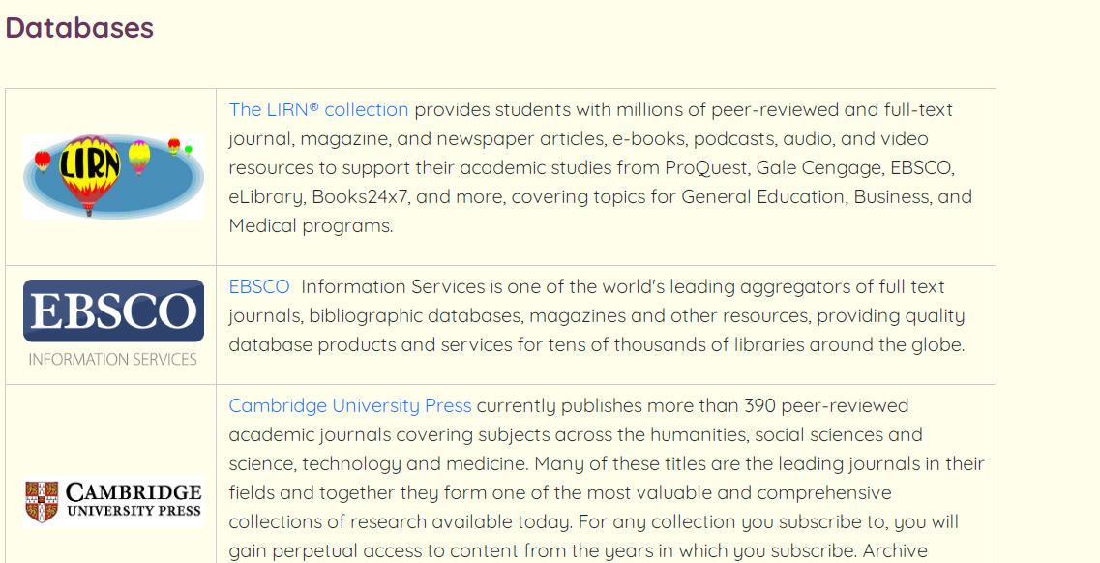
Databases
http://khazar.org/en/item/1306
To access Databases click on: Electronic Resources on library’s home page then,
      Click on Databases
Notes:
Learning starts in the classroom, but it doesn't end there. Now you engage in active, academic learning just about anywhere. What you need — what you can deliver — is a dynamic, online library that meets your needs where you are and supports yours academic objectives.
The most popular library databases of our online library are EBSCO and LIRN portal
EBSCO Academic Search Complete contains numerous full-text journal, magazine, and newspaper articles on a variety of disciplines (social sciences, humanities, science & technology, and general interest
LIRN (Library and Information Resources Network) is the portal of the USA Agape University, includes such popular databases as eBook Proquesr, Gale Academic, Gale Virtual Reference library, Gale eBooks, Literature Resource center, etc
Ebsco Academic Search Complete contains numerous full-text journal, magazine, and newspaper articles on a variety of disciplines (social sciences, humanities, science & technology, and general interest

Slide 20
The Most Popular Databases Access
Title | User name | Password
EBSCO (outside the university) http://search.ebscohost.com | khazar | Research2019!
The LIRN (Library & Information Resources Network) https://www.lirn.net | 32982 | swiftbell78
Free Trials
EBSCO Discovery Service | http://search.ebscohost.com
Britannica Digital Learning | https://britannica.co.uk/about-us
Polpred | https://polpred.com
Notes:
EBSCO Discovery Service (EDS) is a cost-effective search tool that connects patrons to all of your e-resources, including databases, e-books and magazines through a single search box.
Britannica Digital Learning contains Britannica Academic, ( the very best in digital educational materials, access to high quality comprehensive information , written by Nobel laureates l ['lɔːrɪət ,,historians, curators, professors, and other notable experts)
Britannica eBooks Over 1,500 Nonfiction Titles… and Counting!

Slide 21
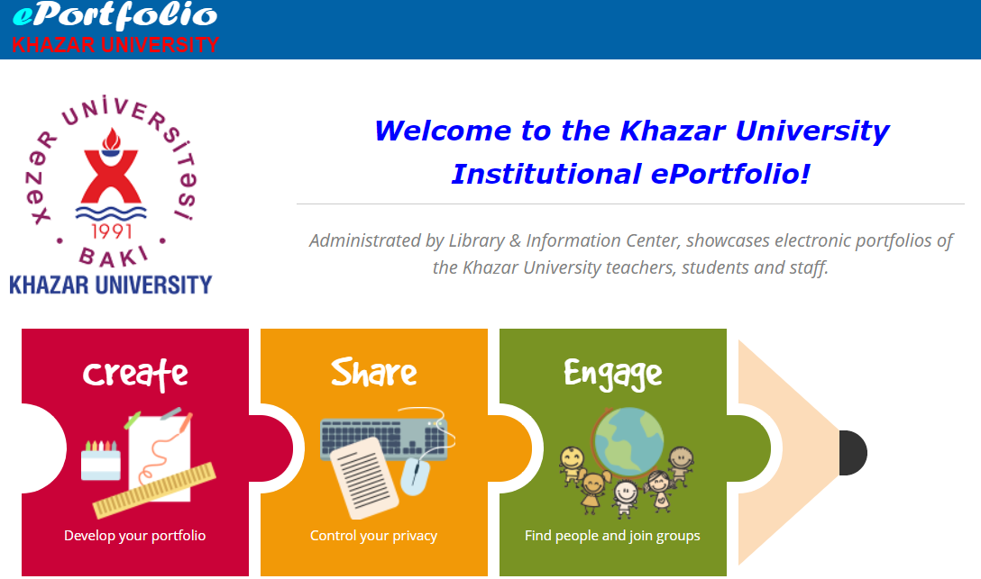
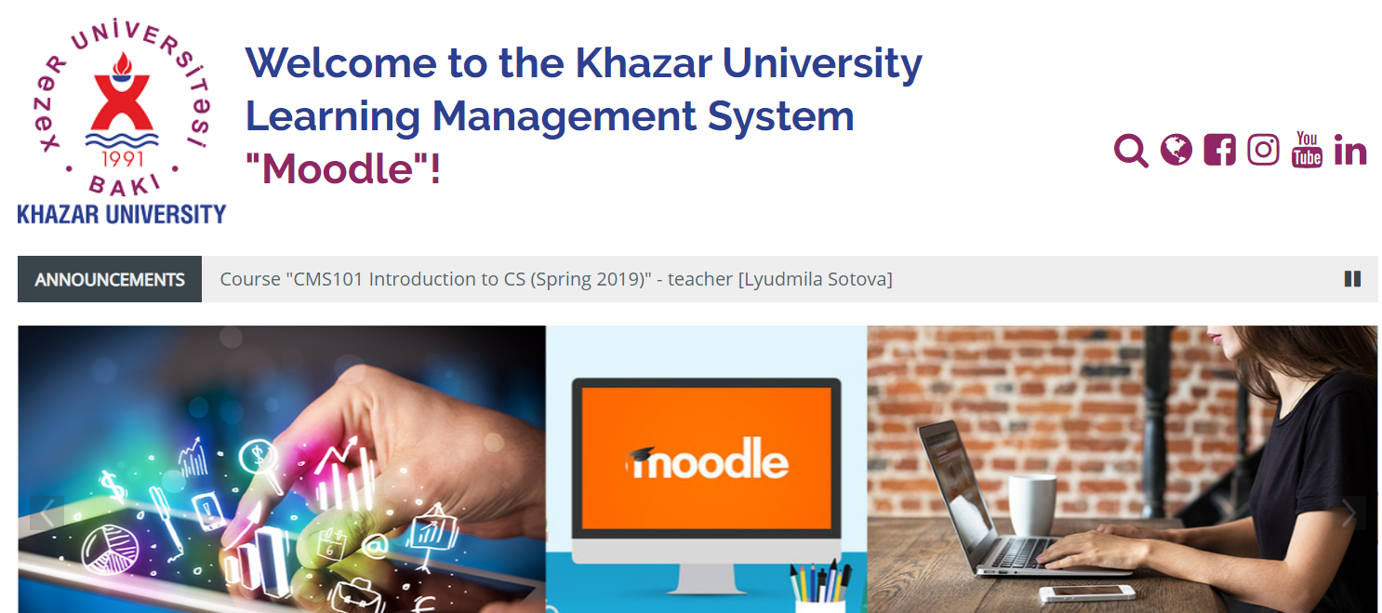
Library Support for eLearning & Research
Doctoral students' theses repository collection at every Khazar University School;
eLearning by Moodle platform (https://elearning.khazar.org);
ePortfolio by Mahara platform (https://eportfolio.khazar.org);
eLibrary- Calibri (http://elib.khazar.org);
Open Access.
Notes:
Moodle
Moodle is a learning platform designed to provide educators, administrators and learners with a single robust, secure and integrated system to create personalised learning environments.
Mahara
Create your electronic portfolio in a flexible personal learning environment
Share your achievements and development in a space you control
Engage with other people in discussion forums and collaborate with them in groups
eLibrary- Calibri contains more than 200 full text books

Slide 22
Open Access Resources
- Directory of Open Access Journals
- Directory of Open Access Books
- Institute of Education Sciences
- MedlinePlus
- Merck Manual - Professional Edition
- PubMed
- GALILEO Scholar Databases
- World Digital Library
- OER Commons

Slide 23
AVOID PLAGIARISM
Give credit to those whose works you use in your research paper.
Cite references within research paper.
List cited references on Reference or Bibliography page.
Consult style manual as guide to citing references.
Consult course instructor for recommended style manual.
See Citation and Writing Style Guides on library’s Web page
http://khazar.org/en/item/1352
Notes:
According to the Oxford Dictionary Plagiarism is: “The practice of taking someone else's work or ideas and passing them off as one's own” In precise words, plagiarism is an act of fraud.

Slide 24
Guides on the Library webpage and
Social networking
LIC provides several user guides:
Helping users become familiar with the library’s services, resources and facilities;
Providing tips on advanced searching:
  How to find …How to search…How to cite…;
  How to access library databases outside the campus network;
  How to reserve a group study room (in the nearest future);
Facebook and Twitter account accessed from the Library webpage.

Slide 25
Summary
LIC provides access to a variety of services and resources to assist with your information seeking needs.
Online catalog used to find books.
Check out materials, including reserves, from Circulation desk.
Electronic Resources used to find journals, magazines newspapers, and E-books.
Style manuals can provide guidance on avoiding plagiarism and on citing references.
Course instructor should be consulted for recommended style manual.

Slide 26

THANK YOU
FOR YOUR ATTENTION!
Contact as: library@khazar.org

