Slide 1
Dissemination Conference
Khazar University
19 October 2018

Slide 2
Paving the way for interregional mobility and ensuring relevance, quality and equity of access

Slide 3
PAWER is an Erasmus+ Capacity Building in the field of Higher Education project with a very ambitious objective.

Slide 4
Wider Objectives:
To foster interregional integration and cooperation developing reliable joint tools for the enhancement of international dimension of the HE systems and the compatibility between the 4 regions and of these with EHEA
To support the modernization, accessibility and internationalization of 23 PC Universities from 8 countries belonging to 4 different regions.

Slide 5
Specific Project Objectives:
To share competences and meanings of credit allocation and grading system and their recognition and transfer for a common methodology
To implement concrete pilot examples and compare students’ performances
To foster the “Credit Mobility” participation and the inter-institutional cooperation
To disseminate results, actions and documents

Slide 6
PAWER OBJECTIVES
Gathering information on ECTS
Preparing analysis of the imlementation
Preparing a pilot examples
Gathering information on CM programs
Signing agreements between partners

Slide 7
PARTNERS
University of L’Aquila, Italy
Wroclaw University of Environmental and Life Sciences, Poland
University of Szeged, Hungary
Middlesex University Higher Education Corporation, UK
University of Chemical Technology and Metallurgy, Bulgaria

Slide 8
Partners
Russia (2 universities +MoE)
Mongolia (2 universities + MoE)
Uzbekistan (3 universities + MoE)
Tajikistan (4 Universities + MoE)
Kazakhstan (4 Universities + MoE)
Kyrgyzstan (3 Universities + MoE)
Georgia (3 Universities + MoE)
Azerbaijan (2 Universities + MoE)

Slide 9
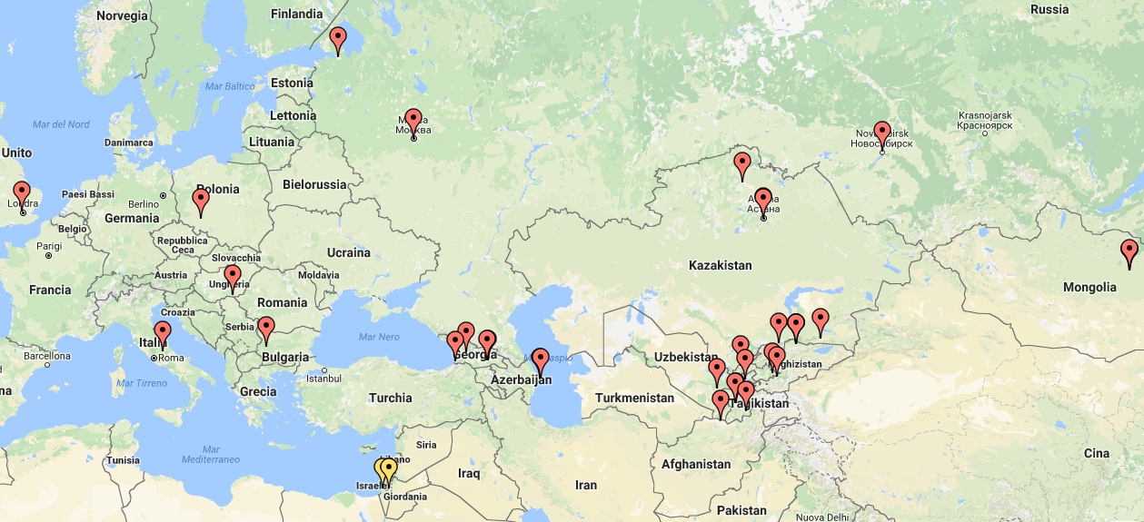
Project participants:
http://www.zeemaps.com/view?group=2420708&x=40.107414&y=50.404796&z=14

Slide 10
Project lifecycle
Application
Competition
Agreements signed
Start
Reporting
Quality plan and control
Idea
Current

Slide 11
Quality Assurance and monitoring
Internal Monitoring and Quality Control Team (IMQCT)
External Quality Control Team
(EQCT)
WUELS will prepare the General Plan for IMQCT, each partner will perform an internal quality report under the coordination of the SC member
EQCT will be performed by an expert subcontracted by UNIVAQ.

Slide 12
WP1: Data collection (Preparation)
1.1. Share of information on the 13 (5EU and 8PC) Framework of Qualifications, credit systems, level of application of ECTS system.
1.2. Knowledge of recognition methodology used in each PC institution, within existing EMA2 projects.

Slide 13
WP2: Organization of study visit (Development)
2.1. Staff selection criteria and pilot group identification in each PC university.
2.2. Training in EU of staff pilot group.

Slide 14
WP3: Enhancement of staff skills and strategy development (Development)
3.1. Constitution of a permanent Local Team in each PC university and preparation of the first draft of the comparative scheme between local credit system and ECTS.
3.2. Comparative scheme reviewed and officially agreed during the first regional meeting.

Slide 15
WP4: Pilot degree courses adaptation (Development)
4.1. Identification of 5 fields of study and description of profiles, by general and specific LOs.
4.2. Allocation of ECTS to each Module.
4.3. Data on Students’ performances for these modules in the last 3 years .
4.4. Synoptic scheme of grade systems and Manual for the correct transfer of grades.

Slide 16
WP5: Quality Control and Monitoring
5.1. Definition of Quality Control and Monitoring strategy and tools.
5.2. Four evaluation reports by the independent evaluator.
5.3. Financial Auditing report.

Slide 17
WP6: Dissemination Strategy and Tools
6.1. Dissemination and Sustainability strategy, production of dissemination material
6.2. Awareness arising on recognition issues through workshops and project website.
6.3. Dissemination of new competence to other institutions. Agreements among PC and EU PPs for continuation of cooperation within “Credit Mobility” projects. Website preparation and updating.
6.4. Involvement of national Authorities (8 Regional meetings).

Slide 18
WP7: Management of the project
7.1. Project management structure and body: financial flows and coordination strategy.
7.2. Local and transnational coordination of the project.
7.3. 4 SC meetings.

Slide 19
Action Plan for the 1st year of the project (October 2016 - September 2017)

Slide 20
1-st year
Preparation
Preparation of a survey
Report on recognition methodology
Development
Selection
Study visit EU
Retraining
Quality
Establishment of Quality Control and Monitoring strategy
First internal report
Dissemination
Information materials
Local meetings
Local meetings
Website preparation and updating
Establishment of PM structure
Management
Establishment of SC
SC meeting
SC meeting
1st meeting
Reports
2nd meeting
M1 M4 M8 M12

